Slide 1
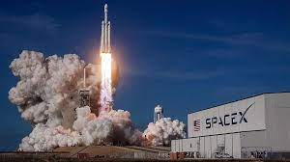

Data Science Capstone Project
Determining Factors Contributing to SpaceX Engine Recovery
Mark A. Farrugia, Ph.D.
https://github.com/markfarrugia29
April 19th, 2022

Slide 2

Presentation Outline
Executive Summary
Introduction
Methodology
Results
Conclusion
Appendix

Slide 3
Executive Summary
The Opportunity: Private space flights are a growing industry, with SpaceX having the best price per launch at $62 million compared to the next best price of $162 million. This is largely due to their ability to capture and reuse their stage 1 rocket.
The Task: SpaceY wishes to generate a machine learning model to predict variables contributing to successful rocket recoveries.
The data: Scrapped SpaceX API and Wikipedia data for launch information based on a variety of temporal and physical parameters.
The methodology: Extracted data using SQL and pandas, prepared preliminary data visualization with Plotly and Seaborn, generated location mapped data using Python libraries Folium and Plotly, predictive analysis of factors contributing to successful launches using Scikit-learn at an 80:20 train:test split.
The outcome: All models have the same accuracy of 83.3% when used on the test set, though Decision Tree had a higher predictive accuracy of 88.9% when used on the training set. This is largely due to the small test sample set, so more data will be needed.

Slide 4
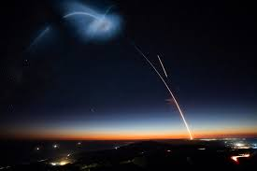
Introduction
Background:
Private companies are vying for personal and government voyages to space
SpaceX has the best pricing ($62M vs $165M in 2022)
Their market advantage is the ability to recover stage 1 of the launch
Deliverable:
Using publicly available launch data from SpaceX, identify the most accurate machine learning model to predict successful stage 1 recovery

Slide 5

Section 1
Overview of Data Collection, Wrangling, Visualization, Dashboarding and Modeling Methods

Slide 6
Methodology
Data collection methodology:
Data of interest on launch time and location, as well as physical parameters of the launch, were extracted with SpaceX public API and Wikipedia page
Performed data wrangling
OneHotEncoding was performed in preparation for model generation and launch success was classified as True Landings and failures as False Landings.
Performed exploratory data analysis (EDA) using Seaborn visualization and SQL
Performed interactive visual analytics using Folium and Plotly Dash
Performed predictive analysis using classification models
GridSearchCV was utilized to tune and prepare KNN, DecisionTree, SVM and Logistic Regression

Slide 7
Data Collection
Data was extracted using a static dataset generated from the SpaceX API, which yielded a .json response which was converted to a Pandas dataframe for analysis. Supplimental data was scrapped from Wikipedia using BeautifulSoup
Source: (https://en.wikipedia.org/w/index.php?title=List_of_Falcon_9_and_Falcon_Heavy_launches&oldid=1027686922)
Columns from the SpaceX API:
FlightNumber, Date, BoosterVersion, PayloadMass, Orbit, LaunchSite, Outcome, flights, GridFins, Reused, Legs, LandingPad, Block, ReusedCount, Serial, Longitude, Latitutde
Columns from Wikipedia Webscraping (novel columns in red):
Flight No., Launch Site, Payload, PayloadMass, Orbit, Customer, Launch Outcome, Version Booster, Booster landing, Date, Time

Slide 8
Data Collection – SpaceX API
A jupyter notebook of the following process can be found at the following URL:
https://github.com/markfarrugia29/IBM-Data-Science-Capstone-Project-SpaceX/blob/main/Capstone%20Project%20SpaceX/Data%20Collection/Data%20Collection%20API%20Lab.ipynb
Request from SpaceX API to obtain .json file
Populate a dictionary with relevant data
Cast the dictionary into a dataframefilter data to only view Falcon 9 launches
Use .json_normalize to generate a dataframe
Replace missing PayloadMass values with mean

Slide 9
Data Collection - Scraping
A jupyter notebook of the following process can be found at the following URL:
https://github.com/markfarrugia29/IBM-Data-Science-Capstone-Project-SpaceX/blob/main/Capstone%20Project%20SpaceX/Data%20Collection/Data%20Collection%20with%20Webscraping.ipynb
Send a Request to Wikipedia
Use BeautifulSoup to Parse the HTML
Identify Launch info in the HTML table
Create a dictionary to populate with said data
Extract data into dictionary via iteration through the table

Slide 10
Data Wrangling
Succesful and Unsuccessful recoveries were classed into binary as 1 and 0, Respectively.
Successful recoveries were keyed as follows:
True ASDS, True RTLS, or True Ocean
Unsuccessful recoveries:
None None, False ASDS, False Ocean, None ASDS, False RTLS
A mean success of 66% was identified on analysis of unsuccessful/successful recoveries.
GitHub URL for code:
https://github.com/markfarrugia29/IBM-Data-Science-Capstone-Project-SpaceX/blob/main/Capstone%20Project%20SpaceX/Data%20Visualization/Data%20Visualization%20Data%20Wrangling%20.ipynb

Slide 11
EDA with Data Visualization
Scatter, bar and line plots were utilized to visualize potential factors contributing to stage 1 recovery rates.
Comparisons:
Flight No. Vs. Payload Mass/Launch Site
Payload Mass Vs. Launch site
Orbit Vs. Success Rate
Payload Mass Vs. Orbit
Flight No. Vs. Orbit
Success over time (years)
Link to github of EDA: https://github.com/markfarrugia29/IBM-Data-Science-Capstone-Project-SpaceX/blob/main/Capstone%20Project%20SpaceX/Data%20Visualization/Data%20Visualization%20with%20plots.ipynb

Slide 12
EDA with SQL
A .CSV file containing SpaceX launch data from 2010-2017 was uploaded to IBM DB2 database
Several SQL queries were performed to get a better understanding of the dataset
Information on launch site names, mission outcomes, booster versions, landing outcomes and payload sizes were obtrained
Github URL: https://github.com/markfarrugia29/IBM-Data-Science-Capstone-Project-SpaceX/blob/main/Capstone%20Project%20SpaceX/Data%20Collection/Exploratory%20Data%20analysis%20with%20SQL.ipynb

Slide 13
Build an Interactive Map with Folium
Python was utilized to generate a folium map to mark successful/unsuccessful launch recoveries as well as to identify proximities to several potential success factors: railways, highways, coasts and cities.
These insights were used to help explain why some sites had higher recoveries relative to others.
Github url:
https://github.com/markfarrugia29/IBM-Data-Science-Capstone-Project-SpaceX/blob/main/Capstone%20Project%20SpaceX/Data%20Visualization/Data%20Visualization%20dashboard%20with%20folium%20and%20ploylt%20Dash.ipynb

Slide 14
Build a Dashboard with Plotly Dash
Dash and Plotly Python libraries were used to generate an interactive dashboard containing two specific visualizations.
First, a pie chart was prepared to show how landings are distributed across all launch sites. This chart can be selected to show individual launch site success rates.
A scatter plot was prepared to take either all sites or individual sites, as well as a selectable payload mass between 0 and 10,000 kg. This lets us determine how success could vary depending on launch site, payload mass and booster version.
Github URL: https://github.com/markfarrugia29/IBM-Data-Science-Capstone-Project-SpaceX/blob/main/Capstone%20Project%20SpaceX/Data%20Visualization/SpaceX_app.py

Slide 15
Predictive Analysis (Classification)
Fit and Transformed Features with StandardScaler
Prepared a train:test split of 80%:20%
Ran GridSearchCV at cv = 10 to find optimal parameters for SVM, LR, Decision Tree and k-NN models
Score models on test dataset
Visualize results for true/false negative/positive with Confusion Matrix
Github URL: https://github.com/markfarrugia29/IBM-Data-Science-Capstone-Project-SpaceX/blob/main/Capstone%20Project%20SpaceX/Model%20generation%20and%20evaluation/Capstone%20Machine%20Learning.ipynb

Slide 16

Section 2

Slide 17
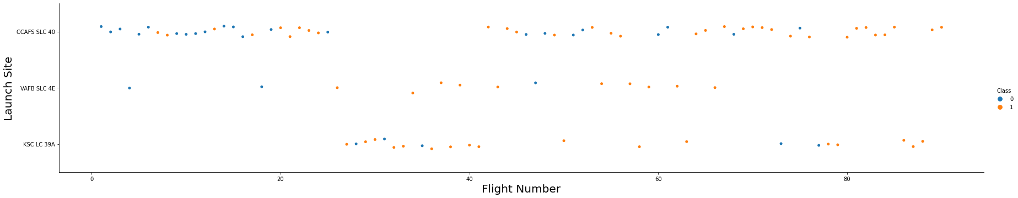
Flight Number vs. Launch Site
Below, we see a scatter plot of the flight number of the launch versus the three launch sites. Successful recoveries are shown in orange and unsuccessful in blue.
The bulk of the failures occurred with early launches (<35), which clustered in site CCAFS SLC 40.

Slide 18
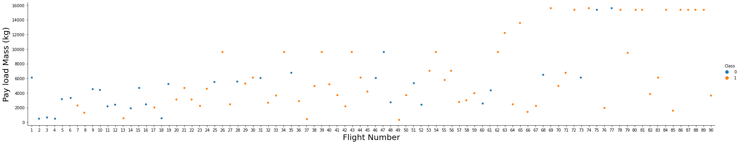
Payload vs. Launch Site
Below, we see a scatter plot of the flight number of the launch versus the total payload mass (kg). Successful recoveries are shown in orange and unsuccessful in blue.
Again, the bulk of the failures occur with earlier launches, but a bulk of the failed recoveries are with payloads less than 10,000 kg.

Slide 19
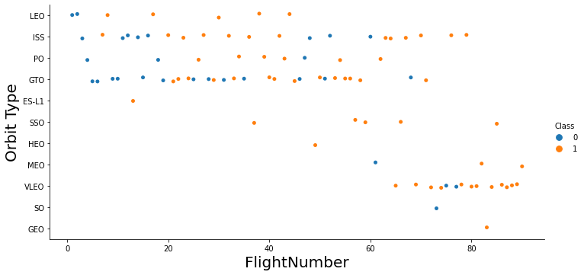
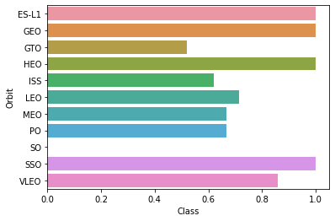
Success Rate/Flight Number vs. Orbit Type
Here we look at flight number versus orbit type. Several orbit types had perfect success rate, but low total launches (ES-L1, HEO, GEO). SSO had a perfect success rate, but relatively low total launches. VLEO had a far higher total launch number with a stellar near 80% recovery rate. SO stands out as a complete failure, but it only had a single launch so no conclusions can be drawn. The remaining launch orbits had middling recovery rates around 50-60%.

Slide 20
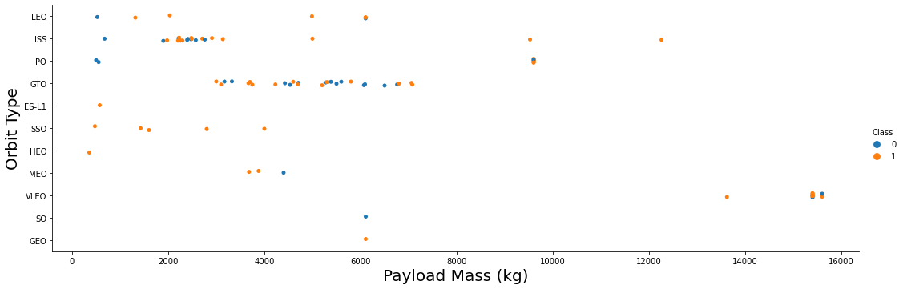
Payload vs. Orbit Type
With heavy payloads, the successful landing are more for Polar orbit, LEO and ISS. However, for GTO we cannot distinguish this well as both positive landing rate and negative landing are both observed.

Slide 21
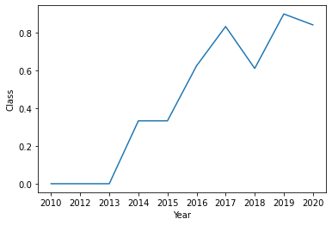
Launch Success Yearly Trend
As a testament to SpaceX’s iterative process, we clearly see an increasing mean success rate (with a perfect rate being 1.0) observed with increasing time.

Slide 22
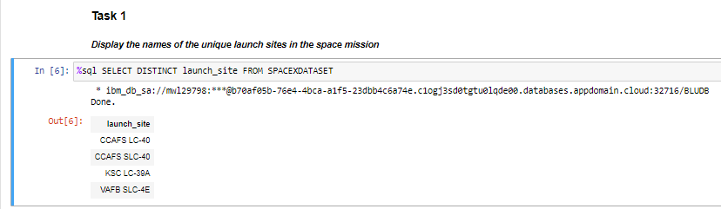
SpaceX utilizes four distinct launch sites. To identify them, we can simply query them with SQL using the DISTINCT command in the SELECT statement. Here we see that CAAFS SLC-40/LC-40, KSC LC-39A and VAFB SLC-4E are the sites.
All Launch Site Names

Slide 23
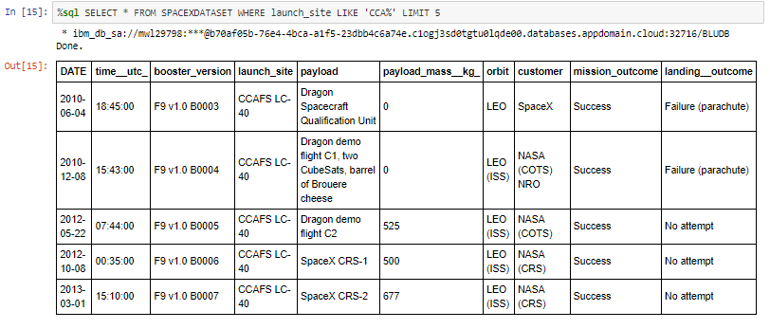
Launch Site Names Begin with 'CCA'
We can explore the records with limits on finding attributes based on launch site, such as searching for launch sites starting with CCA.

Slide 24
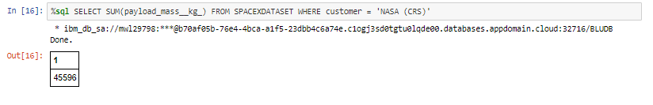
Total Payload Mass
Impressively, we can determine the overall payload mass launched by SpaceX on behalf of NASA. This total payload is 45596 kg as of the writing of this.

Slide 25
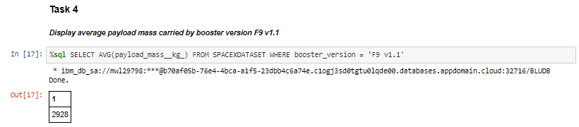
Average Payload Mass by F9 v1.1
We can also drill down into the data and find average launch masses for specific booster versions. Here we can see the average payload mass carried by booster version F9 v1.1 is 2928 kg.

Slide 26
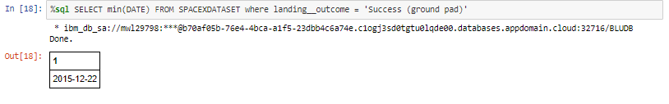
First Successful Ground Landing Date
SpaceX has had successful recoveries since 2014, but the earliest evidence of a successful ground pad launch was on Dec 22nd, 2015.

Slide 27
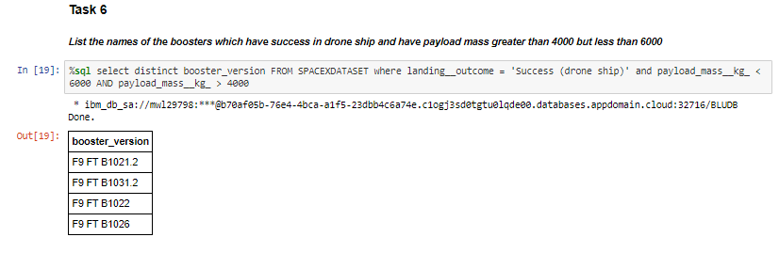
Successful Drone Ship Landing with Payload between 4000 and 6000
Taking a look at specific successful landings on drone ships, we can see how many occurred with a payload between 4000 and 6000 kg.

Slide 28
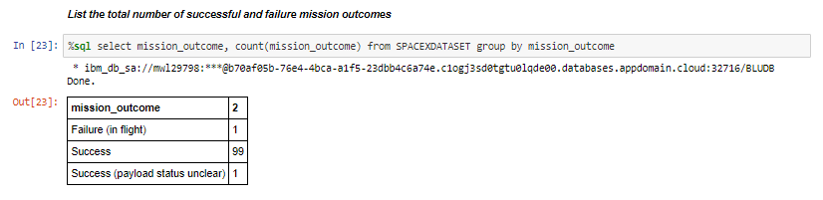
Total Number of Successful and Failure Mission Outcomes
We can also get a sense of the total number of successful vs unsuccessful mission outcomes. Note this is different than recovered stage 1 rockets. Impressively, the success rate of missions is over 99% with SpaceX! This would mean that most recovered launch failures were planned.

Slide 29
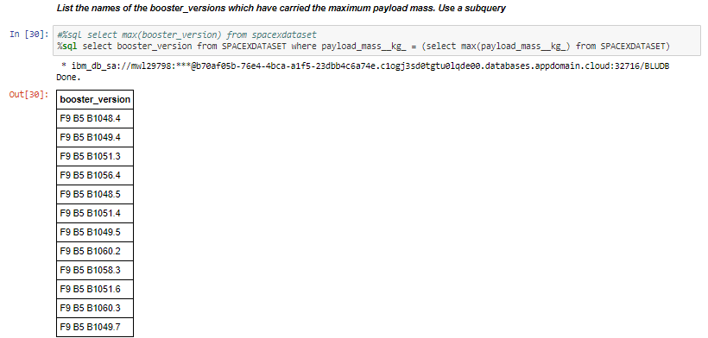
Boosters Carried Maximum Payload
Thinking that payload mass has an effect on success rates, we can identify all of the booster versions that carried the maximum payload amount. All boosters are of the F9 B5 B10**.* type.

Slide 30
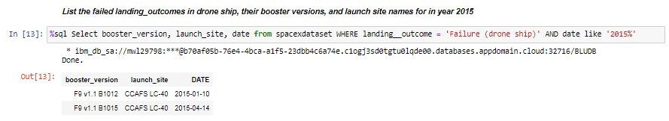
2015 Launch Records
We can also identified failed drone ship landings in the year 2015 and display some features of the events. Only two such events were documented.

Slide 31
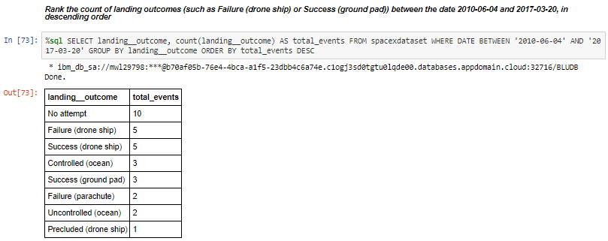
Rank Landing Outcomes Between 2010-06-04 and 2017-03-20
Finally, we can explore all landing outcomes between certain timeframes, such as 2010-2017.
Present your query result with a short explanation here

Slide 32

Section 3

Slide 33

Locations of SpaceX Launch Sites
Using the folium python library, we can plot the locations of each launch site on a map (below)

Slide 34

Identifying Successful/Failed Recoveries Per Launch Site
We can also add identifiers to each site marker by plotting successes (green) and failures (red) on top of the markers. Here, we are looking at VAFB SLC-4E and observing 6 failed landings to 4 successful ones.

Slide 35
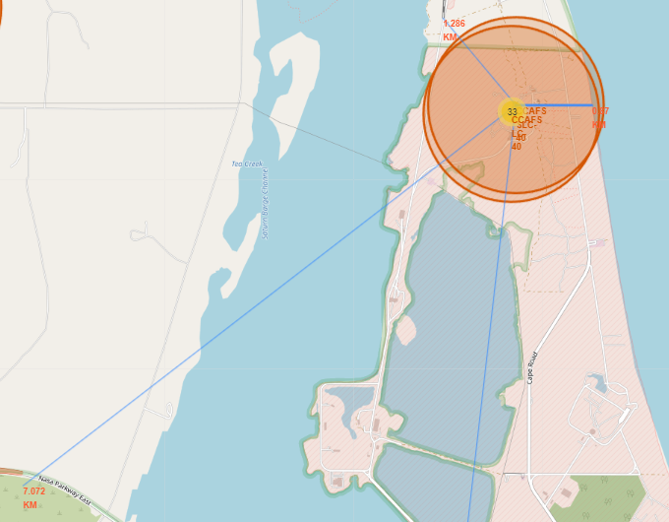
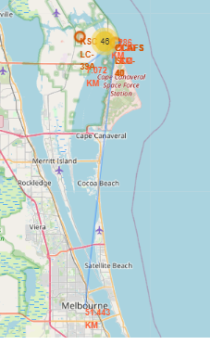
Proximities to Critical Locations/Infrastructure
We can look at the distances from CCAFS SLC-40 to major infrastructure, such as cities, rail lines, highways and coastlines.

Slide 36

Section 4

Slide 37


Pie Chart of Successful Landings For All Launch Sites
Let’s take a look at the total successful stage 1 rocket landings for all launch sites. We can see that KSC LC-39A has the highest share of successful landings, with CCAFS LC-40/CCAFS SLC-40 being 2nd. Please note, CCAFS LC-40 is a name change of CCAFS SLC-40, so they are the same location in reality.
The west coast launch site, VAFB SLC-4E, has the lowest share of successful landings.

Slide 38

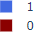
Visualization of Successful/Unsuccessful Landings by Individual Launch Site
Landing History for Launch Site KSC LC-39A
Drilling down to the individual site with the highest share of successful launches, we can see that KSC LC-39A has an exceptionally high success rate with 10 successful landings and 3 failed landings.

Slide 39

Section 5

Slide 40

Classification Accuracy
Several models were generated to predict factors contributing to landing success. However, all four models prepared had the same accuracy when tested against the test data. This is likely due to the small test sample set of 18, but could be due to no clear reason found within the dataset (such as lack of information on sensor data or material used in rocket composition).

Slide 41

Confusion Matrix for Machine Learning Models on Test Data
In addition, all 4 models had the same confusion matrix results when used on the test data. To the right is an example, with 12 true positives, 3 true negatives, 3 false positives and 0 false negatives. Therefore, all models overpredict successful landings and should be tuned with a penalty for selecting false positives.
Having a model that overpredicts successful landings (underpredicts failures) in this case is a liability, as it would lead to launches with higher likelihoods of failed recovery and, thus, increased cost due to increased rocket loss.

Slide 42
Conclusions
The challenge: Generate a machine learning model for Allon Mask of SpaceY to predict stage 1 rocket launch successes to reduce launch costs.
The method used: Obtained data from SpaceX’s public API and web scraping the SpaceX Wikipedia page. Wrangle data and generate dashboards and folium maps to visualize the data .Train several machine learning models to predict successes/failures.
The result: Prepared several machine learning models with accuracies of 83% on test data and recall of 100%. However, the precision sits at 80% due to overestimating successful launches.
The next step: Additional data is required to generate machine learning models with higher accuracy. In addition, model parameters should be adjusted to de-incentivize false positives and risk launch losses.

Slide 43


